Slide 1
Textual Criticism
An Examination of Two Passages of Scripture
Notes:
2 Timothy 3:14-17 But continue thou in the things which thou hast learned and hast been assured of, knowing of whom thou hast learned them; And that from a child thou hast known the holy scriptures, which are able to make thee wise unto salvation through faith which is in Christ Jesus. All scripture is given by inspiration of God, and is profitable for doctrine, for reproof, for correction, for instruction in righteousness: That the man of God may be perfect, thoroughly furnished unto all good works.
These words are just as true today as they were when the apostle Paul told them to Timothy. Never cease to be amazed at the Word of God that you can hold in your hands. Do not lose faith it it! You can be assured that you indeed have the Word of God which contains the plan of salvation. You have the text that tells you how to get from earth to heaven.
The world however constantly attacks the Word of God. It is true that we do not have any of the original autographs. All we have are copies of copies of copies. Because of this the world has tried to convince us that there is no way we can know that we have the original Word of God. Both the Book of Mormon and the Quran state that they provide corrections or restoration of scriptures that have been lost from the original Word. When something is so high and perfect you can attack it all you want but you are still beneath it.

Slide 2
Textual Criticism
“the ascertainment of the true form of a literary work, as originally composed and written down by its author”
Notes:
So if we don’t have the original writings how do we know that we have the true Word of God? We know because the copies have been examined for 2000 years through the process of textual criticism. All ancient writings go through a process of textual criticism. Not just the new testament.

Slide 3
Textual Variants
The task of textual critics, those who study the extant manuscript evidence that attests to the text of the New Testament, is to examine textual variants (i.e., divergencies among the manuscripts) in an effort to reconstruct the original reading of the text.
Notes:
Why are their textual variants? Scribes, skipped a line, skipped a letter, from memory replaced a word. Do I have any textual variants in my copy I gave to Kathy? No. because I printed it.

Slide 4
Author Date-Written Time-Span # Accuracy
Pliny A.D. 61-113 750 yrs 7 ----
Plato 427-347 B.C. 1,200 yrs 7 ----
Demosthenes 4th Cent. B.C. 800 yrs 8 ----
Herodotus 480-425 B.C. 1,300 yrs 8 ----
Thucydides 460-400 B.C. 1,300 yrs 8 ----
Euripides 480-406 B.C. 1,300 yrs 9 ----
Aristophanes 450-385 B.C. 1200 10 ----
Caesar 100-44 B.C. 1,000 10 ----
Tacitus A.D. 100 1,000 yrs 20 ----
Aristotle 384-322 B.C. 1,400 49 ----
Homer (Iliad) 900 B.C. 500 643 95%
New Testament A.D. 50-100 <100 yrs 5795 99.5%
Notes:
Textual Criticism is for all ancient writings! Accuracy is not calculated unless you have a lot of copies.

Slide 5
In one sense, the work of textual critics has been unnecessary, since the vast majority of textual variants involve minor matters that do not affect doctrine as it relates to one’s salvation. Even those variants that might be deemed doctrinally significant pertain to matters that are treated elsewhere in the Bible where the question of genuineness is un-obscured. No feature of Christian doctrine is at stake. Variant readings in existing manuscripts do not alter any basic teaching of the New Testament. Textual critics have been successful in demonstrating that currently circulating New Testaments do not differ substantially from the original. When all of the textual evidence is considered, the vast majority of discordant readings have been resolved and one is brought to the firm conviction that we have in our possession the New Testament as God intended. (e.g., Metzger, 1978, p. 185).
Notes:
Accuracy is not calculated unless you have a lot of copies.

Slide 6
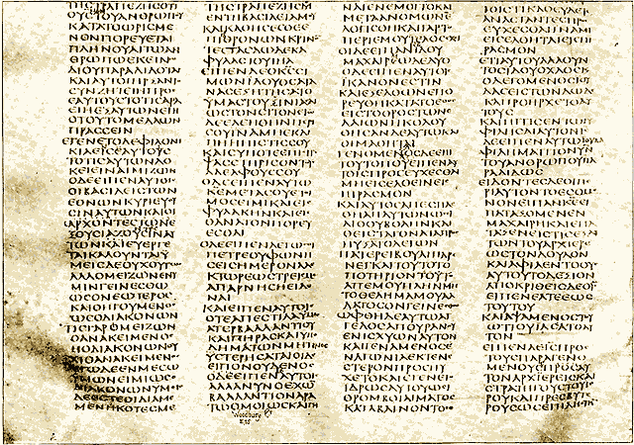
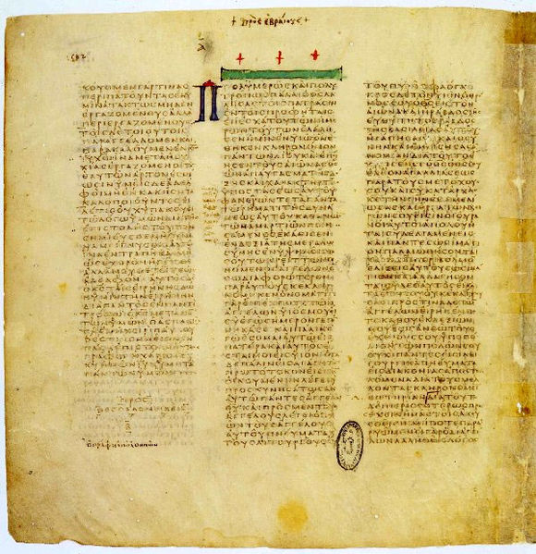
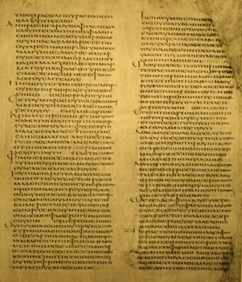
The Big 3 Uncials
Codex Sinaiticus 330-360
Codex Vaticanus 325-350
Codex Alexandrinus 400-440
Notes:
Uncials, no spaces between words or chapters or books and all capital letters
Sinaiticus – fairly complete (British Library)
Vaticanus – missing last four books and some of Hebrews (Vatican Library)
Alexandrinus – Matt 25, John 2 and 1 Corinthians 3 (British Library)

Slide 7
Mark 16:9-20
1.) Inclusion
2.) Omission
3.) the inclusion of 16:9-20 with the insertion of an additional statement between verse 8 and verse 9 that reads: “But they reported briefly to Peter and those with him all that they had been told. And after this Jesus himself sent out by means of them, from east to west, the sacred and imperishable proclamation of eternal salvation”

Slide 8
Mark 16:9-20
4.) the inclusion of 16:9-20 with the insertion of an additional statement between verses 14 and 15 which reads:
And they excused themselves, saying, “This age of lawlessness and unbelief is under Satan, who does not allow the truth and power of God to prevail over the unclean things of the spirits [or, does not allow what lies under the unclean spirits to understand the truth and power of God]. Therefore reveal thy righteousness now”—thus they spoke to Christ. And Christ replied to them, “The term of years of Satan’s power has been fulfilled, but other terrible things draw near. And for those who have sinned I was delivered over to death, that they may return to the truth and sin no more, in order that they may inherit the spiritual and incorruptible glory of righteousness which is in heaven.”
Notes:
Reject 4 and 3 as spurious

Slide 9
NIV
[The earliest manuscripts and some other ancient witnesses do not have Mark 16:9-20]
NKJV
Verses 9–20 are bracketed in NU-Text as not original. They are lacking in Codex Sinaiticus and Codex Vaticanus, although nearly all other manuscripts of Mark contain them.
Notes:
Some???? Not present in the Codex Sinaiticus and Codex Vaticanus. It is present in 99% of all Greek manuscripts available to us including the Alexandrinus.
Nestle-Aland Greek New Testament (N) and in the United Bible Society's third edition (U)

Slide 10
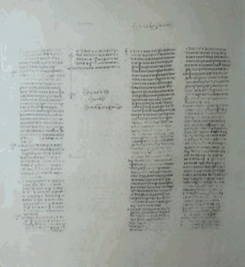
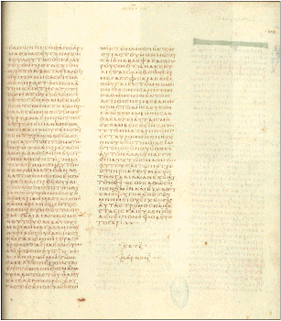
Sinaiticus & Vaticanus
Notes:
Only place is the books where there are blank columns. Markan words.

Slide 11
Irrelevance due to Other References
Appearance to Mary
(Luke 8:2; John 20:1-18),
Appearance on the road to Emmaus
(Luke 24:35),
Appearance to the eleven apostles
(Luke 24:36-43; John 20:19-23)
The “Great Commission”
(Matthew 28:18-20; Luke 24:46-48),
The Ascension
(Luke 24:51; Acts 1:9).
The signs of the apostles:
Matt. (28:20), Heb. (2:3-4), John ch. 14-16 Acts
Notes:
These 12 verses contain no teaching of significance that is not taught elsewhere in the Bible. Mark 16:16 --→ 1 Peter 3:21

Slide 12
I John 5:7-8
Johannine Comma (KJV and NKJV)
7. For there are three that bear record in heaven, the Father, the Word, and the Holy Ghost: and these three are one.
8. And there are three that bear witness in earth, the spirit, and the water, and the blood:
and these three agree in one.
Notes:
Comma-short clause, Not found in any Greek manuscript before the 16th century.

Slide 13
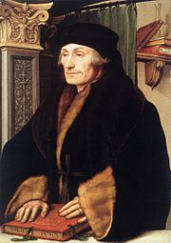
Erasmus (1522-3rd edition)
'Is it negligence and impiety, if I did not consult manuscripts which were simply not within my reach? I have at least assembled whatever I could assemble. Let Lee produce a Greek MS. which contains what my edition does not contain and let him show that that manuscript was within my reach. Only then can he reproach me with negligence in sacred matters.'
Notes:
Edward lee presented a Greek manuscript that contained it. Housed in Trinity college in Dublin, Ireland. Added it to his 3rd edition but with a footnote that it most likely had been fabricated to embarrass him.
Why hadn’t the church fathers used it in their arguments? Because they didn’t have it and if it wasn’t written by the 4th century it wasn’t written by John.

Slide 14
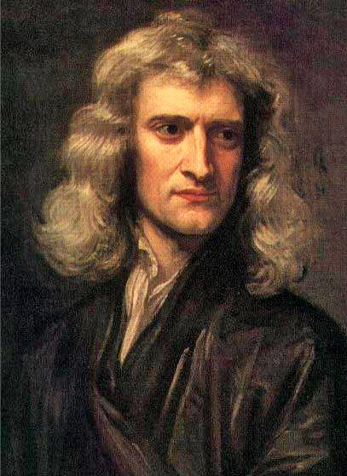
Isaac Newton
In all the vehement universal and lasting controversy about the Trinity this text of the "three in heaven" was never once thought of. It is now in everybody’s mouth and accounted the main text for the proof and would assuredly have been so too with them, had it been in their books.

Slide 15
Other Proofs
All authority in heaven and on earth has been given to me. Therefore go and make disciples of all nations, baptizing them in the name of the Father and of the Son and of the Holy Spirit ---Matthew 28:19
May the grace of the Lord Jesus Christ, and the love of God, and the fellowship of the Holy Spirit be with you all
---2 Corinthians 13:14
To God’s elect...who have been chosen according to the foreknowledge of God the Father, through the sanctifying work of the Spirit, for obedience to Jesus Christ and sprinkling by his blood ---1 Peter 1:1-2
Notes:
The Triune God is scriptural and we do not need to use made up passages to prove it. So we’ve discussed two passages: The textual criticism demonstrates that one passage should be there and the other shouldn’t. This is not meant to test your faith. It is meant to increase your faith. Rick has already read this excerpt from JW. McGarvey’s book on the Evidences of Christianity but I feel it is so good I want to end with it.

Slide 16
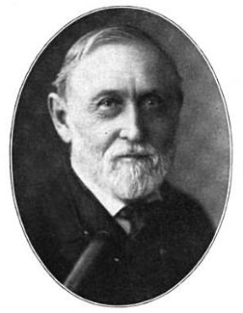
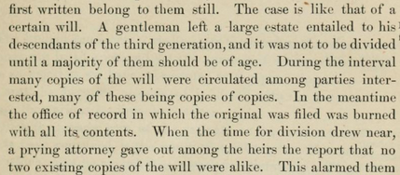
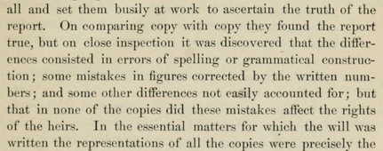
J.W. McGarvey
Pg 17. Evidences of Christianity

Slide 17
Psalm 19:7
The Word of God is perfect, converting the soul
Notes:
Cherish the word of God. Examine the Word of God. Live in the Word of God. Obey the Word of God as we stand and sing.

